Slide 1
ESP32 Low Power
Here is where your presentation begins

Slide 2
TABLE OF CONTENTS
01
02
03
INTRODUCTION
ABOUT ESP32
ESP32 THINGSBOARD
04
05
ESP32 AS WEARABLE DEVICE
ESP32 LOW POWER

Slide 3
01
INTRODUCTION

Slide 4
LAST YEARS
Link github (https://bit.ly/30RHsZ3) https://github.com/hasbiida/TrainingEspRpi
ESP32 – Cloud/Rpi (dash python+database)
ESP32 simple webserver

Slide 5
HIGHLIGHTS THIS YEARS
ESP32 as Wearable device
02
ESP32 Thingsboard
01
ESP32 low power
03
How to plot sensor data to smartphone (esp as webserver)
ESP32 as IoT node devices
How to tuning ESP for lower energy usage

Slide 6
ABOUT ESP32
02

Slide 7
GETTING STARTED
01
03
02
ESP32
PROGRAMMING ENV
SPEC
A feature-rich MCU with integrated Wi-Fi and
Bluetooth connectivity for a wide-range
of applications
Arduino IDE
Espressif IDF
Micropython
JavaScript
LUA
Dual core
Wi-Fi and bluetooth
32 bit programs.
Freq up to 240MHz and it has a 512 kB RAM
30 or 36 pins

Slide 8
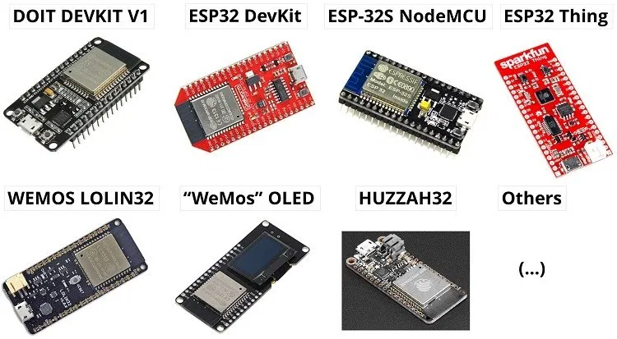
EXAMPLES OF ESP32 BOARDS

Slide 9
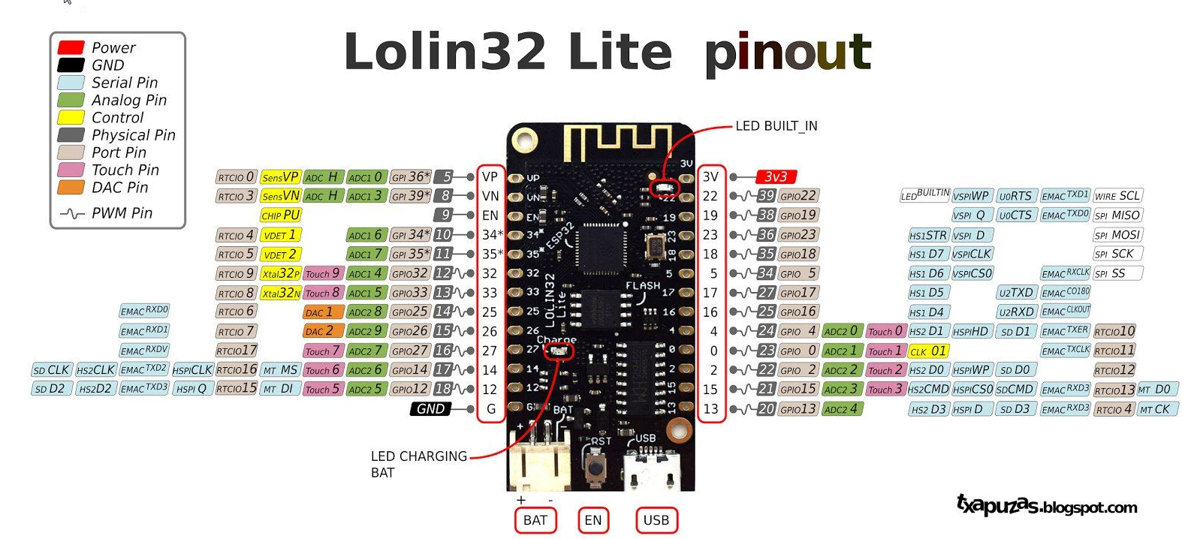

Slide 10

ARDUINO IDE
Install IDE
Add board manager URL
https://dl.espressif.com/dl/package_esp32_index.json
Tools → board → board manager → esp32
Open example blink
change pin 22 (led built in)
Upload

Slide 11
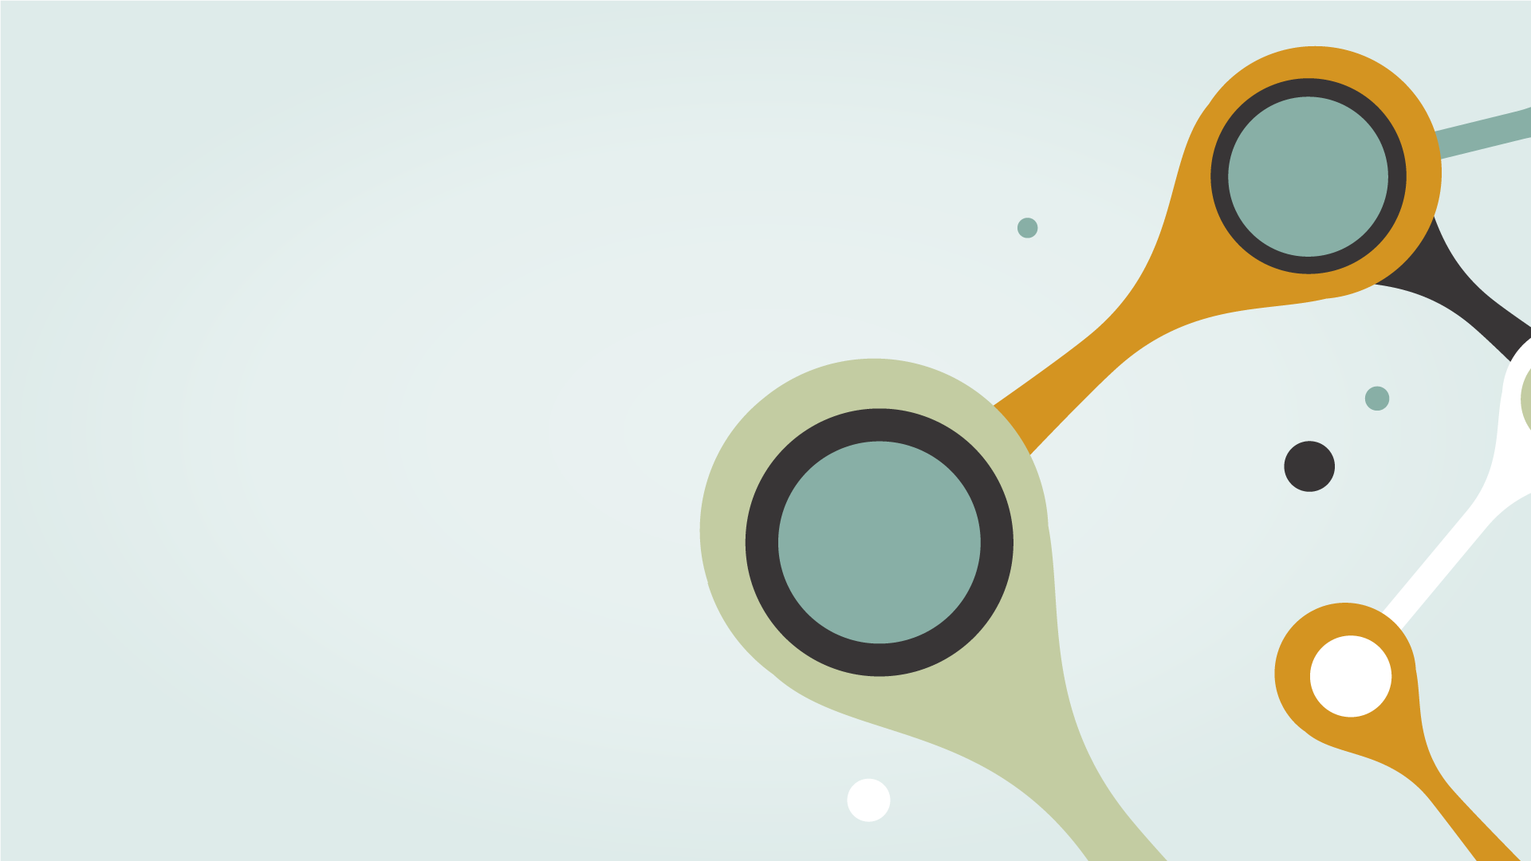
ESP32 THINGSBOARD
03
ESP32 as IoT node devices

Slide 12
Download bahan materi https://github.com/hasbiestheim/FGD_Tel-U_2020 https://bit.ly/3iPmUGG

Slide 13
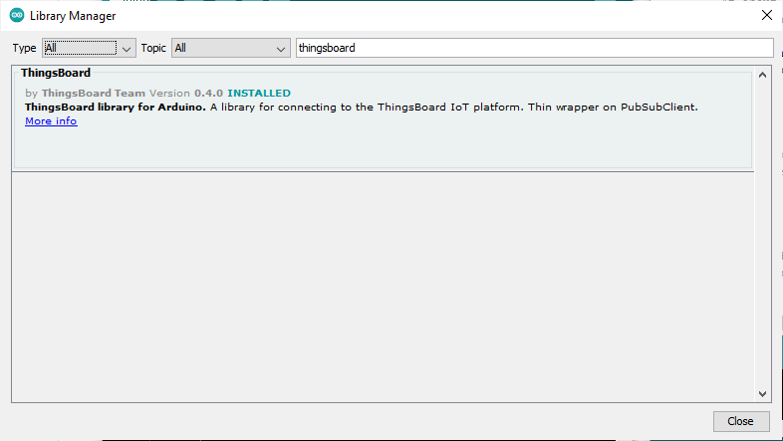
INSTALL LIBRARY
Thingsboard
ArduinoHttpClient
ArduinoJson
DHT sensor library

Slide 14
PROGRAM NODE IOT THINGSBOARD
Untuk sensor DHT11
ESP32_thingsboard_DHT11
Untuk sensor Pulse Sensor
ESP32_thingsboard_PulseSensor

Slide 15
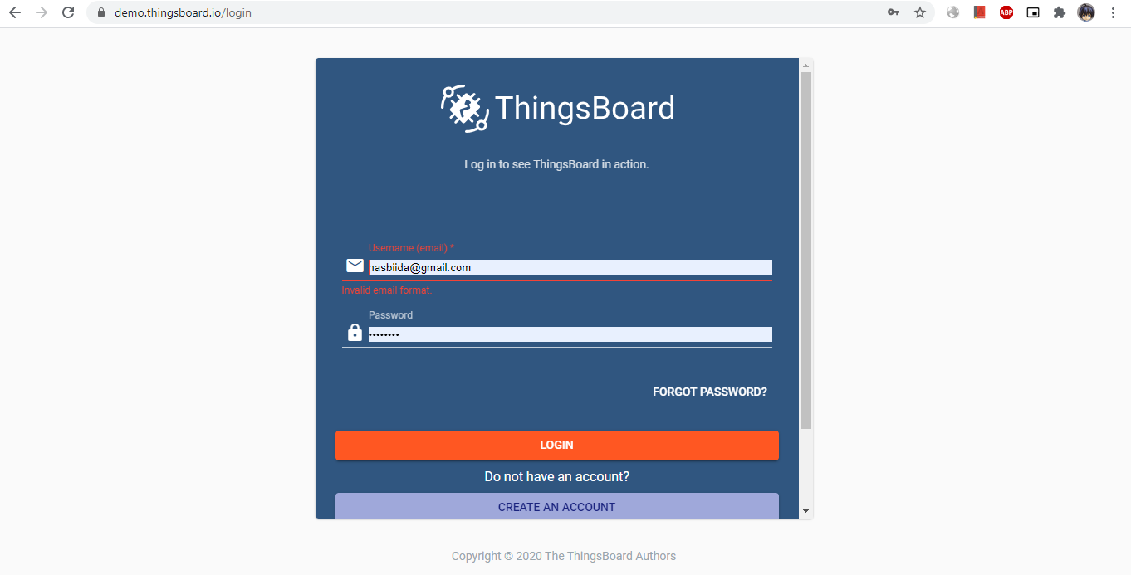
THINGS BOARD LOGIN

Slide 16
THINGSBOARD DASHBOARD
ThingsBoard is an open-source server-side platform yang memungkinkan untuk monitor dan control perangkat IoT. Gratis untuk digunakan secara personal dan commercial dan dapat digunakan dimana saja

Slide 17
FITUR DARI THINGSBOARD
Provision perangkat, aset, dan pelanggan serta menentukan hubungan di antara mereka.
Kumpulkan dan visualisasikan data dari perangkat dan aset.
Menganalisis telemetri yang masuk dan memicu alarm dengan pemrosesan peristiwa yang kompleks.
Kontrol perangkat Anda menggunakan remote produce call(RPC).
Buat alur kerja berdasarkan life cycle perangkat, event, REST API, RPC request, dll
Desain dasbor dinamis dan responsif serta telemetri perangkat atau aset dan wawasan terkini kepada pelanggan Anda
Aktifkan fitur khusus kasus penggunaan menggunakan rule-chain yang dapat disesuaikan.
Push data perangkat ke sistem lain.
demo.thingsboard.io/

Slide 18
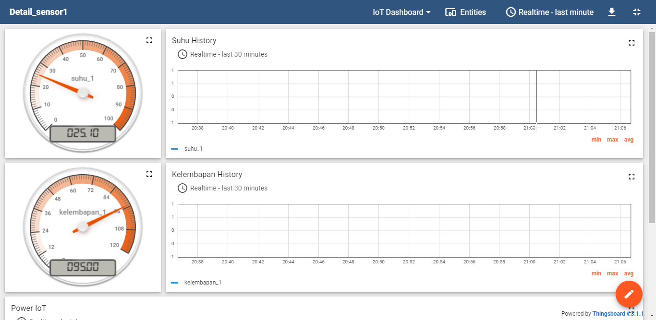
THINGSBOARD

Slide 19
KONEKSI ESP DENGAN THINGSBOARD
Add device dan copy access token pada demo.thingsboard.io
Sesuaikan access token dengan device node (esp32)
Cek koneksi pada telemetry
Buat dashboard dengan data sesuai datatelemetry

Slide 20

INTERNET ALL THE THINGS

Slide 21

ESP32 AS WEARABLE DEVICE
04
How to plot sensor data to smartphone (esp as webserver)

Slide 22
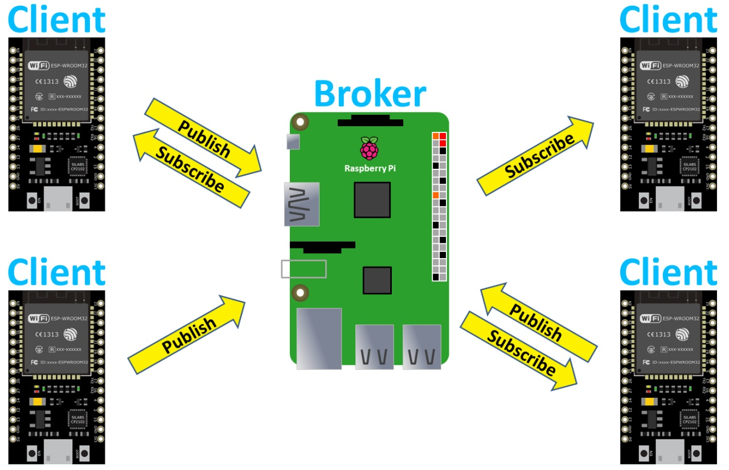
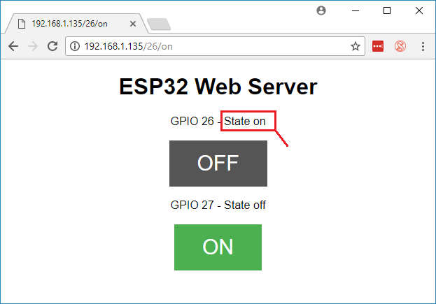
PERBEDAAN
ESP AS WEBSERVER
ESP AS CLIENT

Slide 23
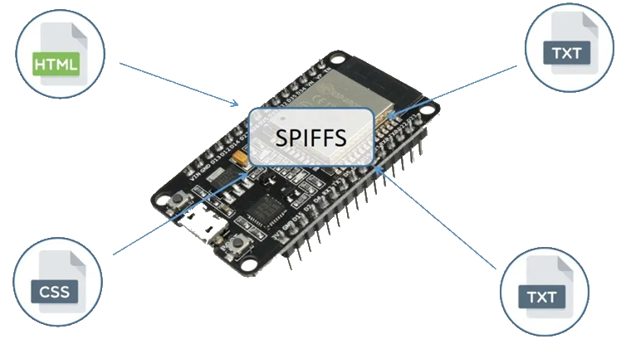
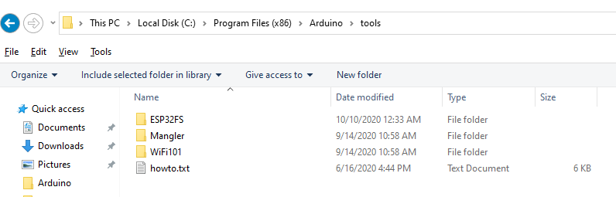
Install ESP32 Filesystem Uploader in Arduino IDE
Arduino IDE directory, and open the Tools
Copy folder ESP32FS to Tools folder
Restart Arduino IDE

Slide 24
Plot Sensor Readings in Real Time Charts – Web Server
Install Filesystem uploader plugin
Install Libaries ESPAsyncWebServer and AsyncTCP
Uploading Code and Files - Tools > ESP32/ESP8266 Data Sketch Upload
Web Server using SPIFFS (SPI Flash File System)
Notes:
server.on("/style.css", HTTP_GET, [](AsyncWebServerRequest *request){ request->send(SPIFFS, "/style.css","text/css");

Slide 25

05
ESP32 LOW POWER
How to tuning ESP for lower energy usage

Slide 26
DESAIN METRIC
METRIC (1- 5) | PRIORITY | ADVANTAGES | DISADVANTAGES
CONNECTIVITY | 3 | Low power | Lambat dan jarak dekat
POWER MANAGEMENT | 5 | Small battery | Low performance
SECURITY | 2 | Low cost | Unsecure
COMPLEXITY | 3 | Mudah digunakan | Terbatas
RAPID EVOLUTION | 1 | Arduino support | Terbatas

Slide 27
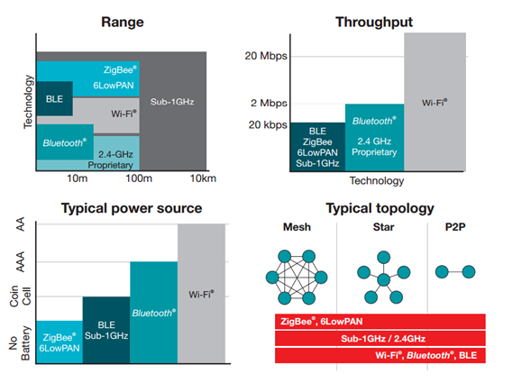
PARAMETER CONNECTIVITY
Range
Throughput
Power source
Topology
Notes:
Mau diaplikasikan kemana aja
Seberapa cepat datanya/realtime
Catu daya batrai/selfpowered/grid
Simple start sampai gateway

Slide 28
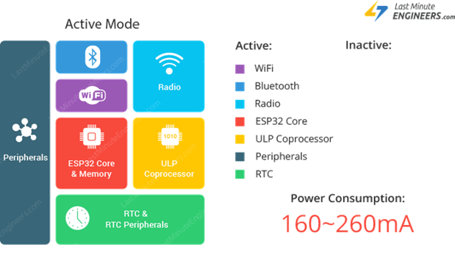
ESP32 Power Modes
Active Mode
Modem Sleep Mode
Light Sleep Mode
Deep Sleep Mode
Hibernation Mode

Slide 29

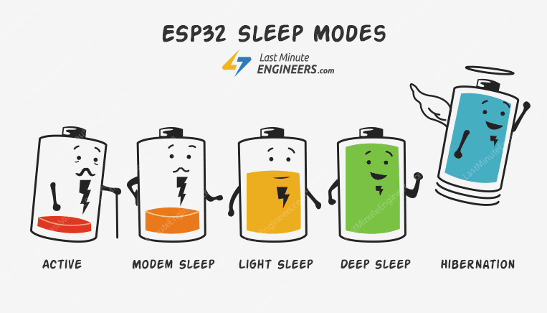
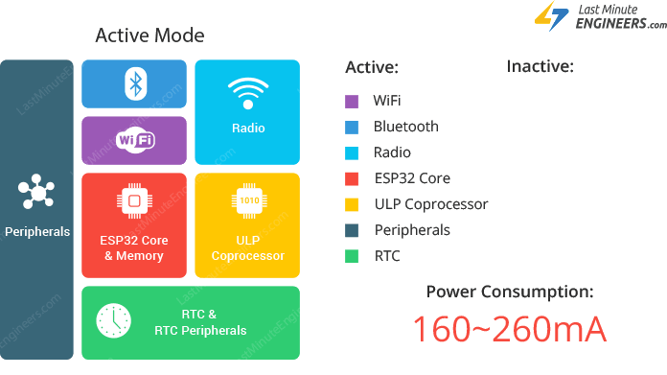
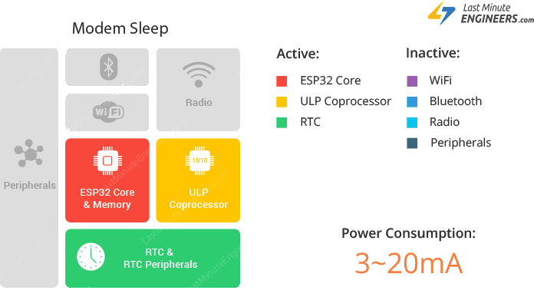
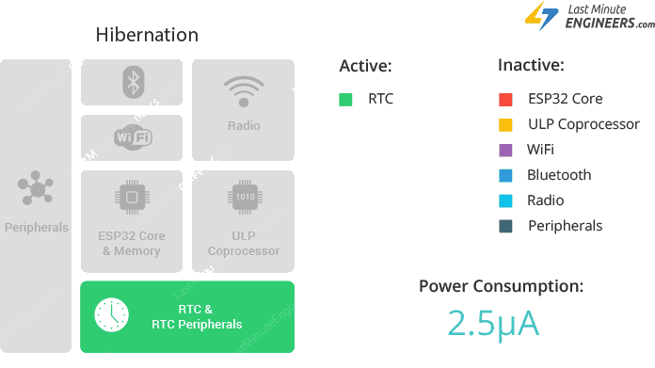
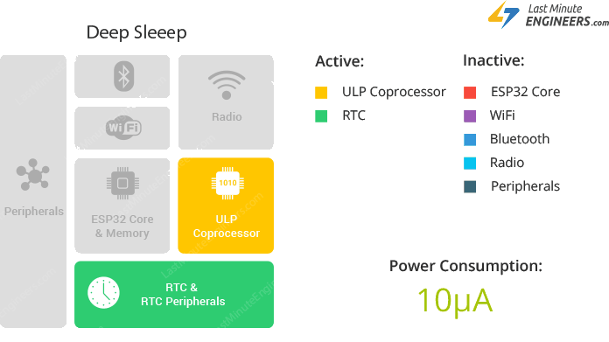
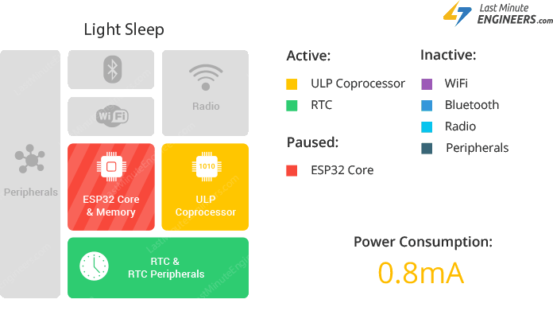
Notes:
What is Clock Gating?
Clock gating is a technique for reducing the dynamic power consumption.
It disables portions of the circuitry by powering off clock pulses, so that the flip-flops in them do not have to switch states. As switching states consumes power, when not being switched, the power consumption goes to zero.

Slide 30
Code Diff (Thingsboard sleepy) using sleep timer
RTC store data
Init sleep timer (waker)
Function to print cause of wake up
Sleep command in main program
RTC_DATA_ATTR int bootCount = 0;
esp_sleep_enable_timer_wakeup(time_in_us)
void print_wakeup_reason()
esp_deep_sleep_start()

Slide 31
Code Diff (Chart webserver sleepy) using touch wake up
RTC_DATA_ATTR int bootCount = 0;
RTC store data
Init touchpin and threshold sensitivuty (waker)
Function to print cause of wake up
Sleep command in main program
#define Threshold 40
﻿touchAttachInterrupt(T3, callback, Threshold);
void print_wakeup_reason()
esp_sleep_enable_touchpad_wakeup()﻿

Slide 32
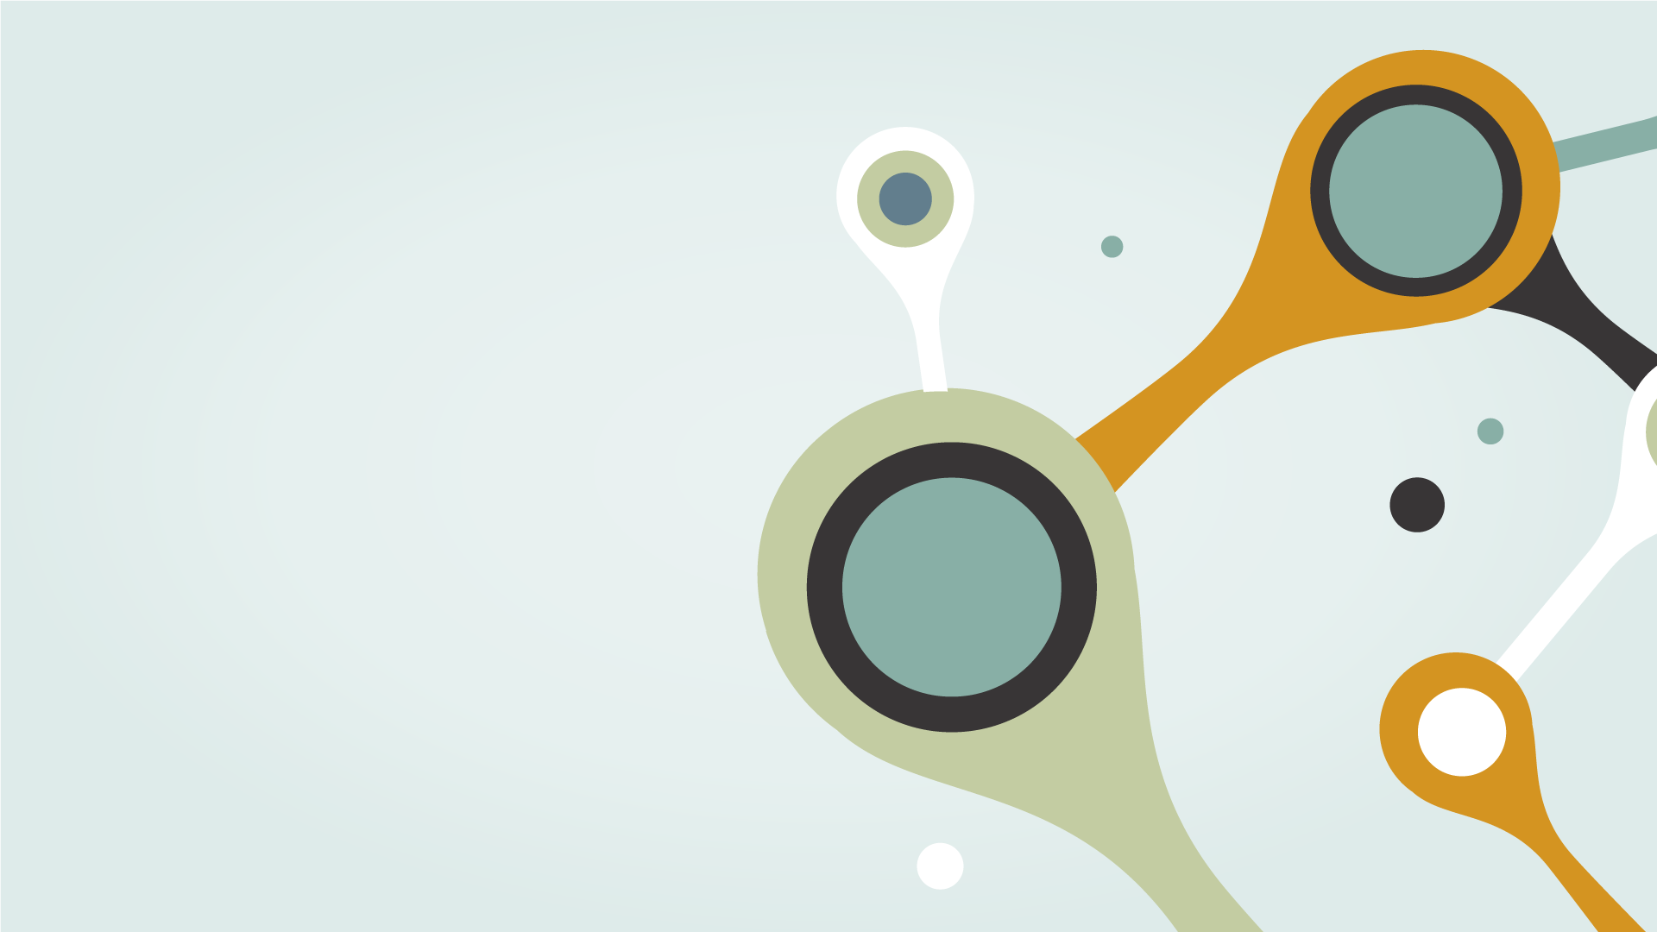
THANKS
Do you have any questions?
hasbiida@gmail.com
Please keep this slide for attribution

